Slide 1
Accelerate ab-initio calculations using universal machine learning (ML) potentials and related tools
Karim Elgammal
karim.elgammal@aucegypt.edu

Slide 2
What are universal ML potentials
They aren’t structure-property relationships ML models
Consider it another force field, giving you near quantum mechanical accuracy
Universal here = general enough to work with most of the periodic table elements

Slide 3
Why universal ML potentials are needed
Quantum mechanical methods like ab-inito are computationally expensive
Potential to accelerate discovery of new materials or accelerate density functional theory (DFT) calculations (an ab-initio method)
Accuracy vs. efficiency trade-off
Availability of computational resources
Machine learning (ML) potentials could accelerate ab-initio calculations by providing a balance between computational efficiency and accuracy

Slide 4
Building ML potentials and examples
Generate/fetch Training Data
Process Atomic Information
Design Neural Network
Train the Model
Test and Apply
Use high-throughput data banks (materials project, materials cloud…etc)
Generate training set by running DFT calculations for diverse atomic configurations
Include different structures, compositions, and conditions
Convert atomic positions and species into ML-friendly inputs
dictumst.
Ensure preservation of physical symmetries (rotation, translation)
Choose architecture (typically Graph Neural Networks)
Include physical constraints in model design
Set up energy and force predictions
Optimize using DFT energies and forces
Balance accuracy between energy and force predictions
- Validate against test set
Verify physical properties and stability
Run molecular dynamics or structure optimization
Check predictions against DFT benchmarks

Slide 5
How to start?
ML potentials come in different variations and flavors with distinct architectures and use cases
Popular examples with unique strengths:
OrbModels: Fast, scalable potential (3-6x faster), includes Grimme-D3 corrections
CHGNet: Specializes in charge-informed modeling, good for magnetic materials, transition metals
MatGL: Graph-based library with multiple architectures (M3GNet, MEGNet) for broad material properties
Key differences:
Architecture: Graph networks vs transformers vs message passing
Speed vs Accuracy tradeoffs
Specific features (charge, magnetism, dispersion forces)
Common traits:
All aim for DFT-level accuracy
Most use Materials Project data
Support atomic simulations (MD, relaxation)

Slide 6
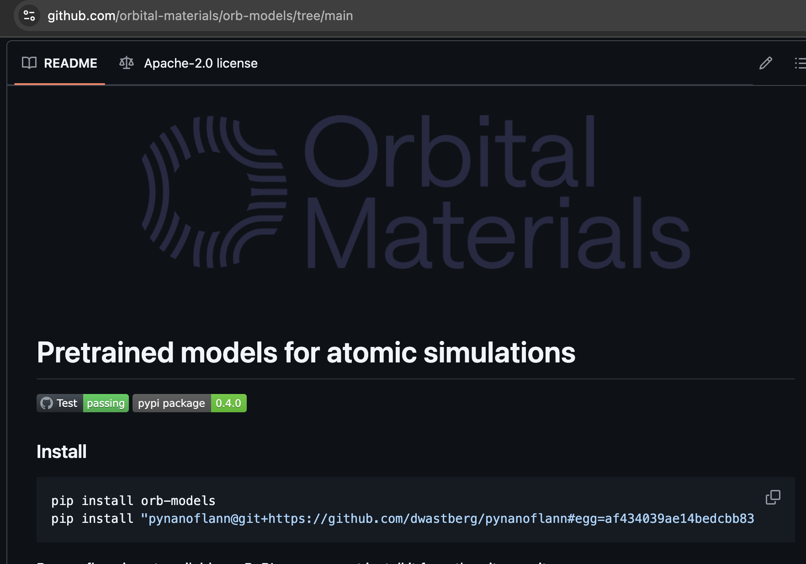
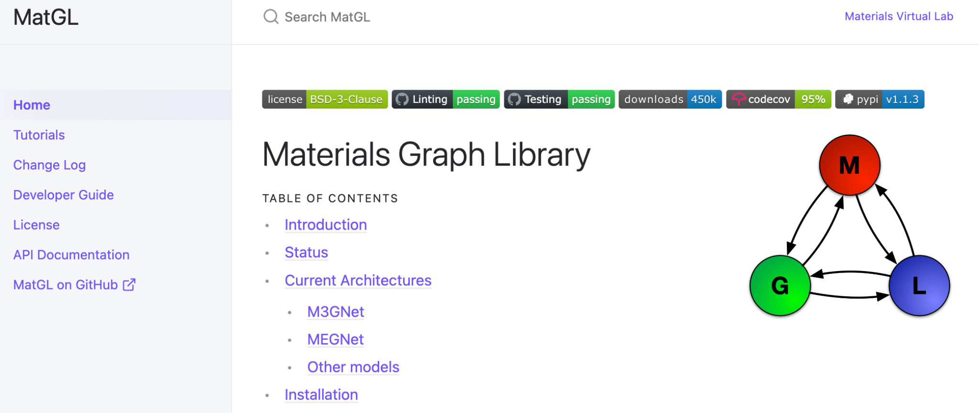
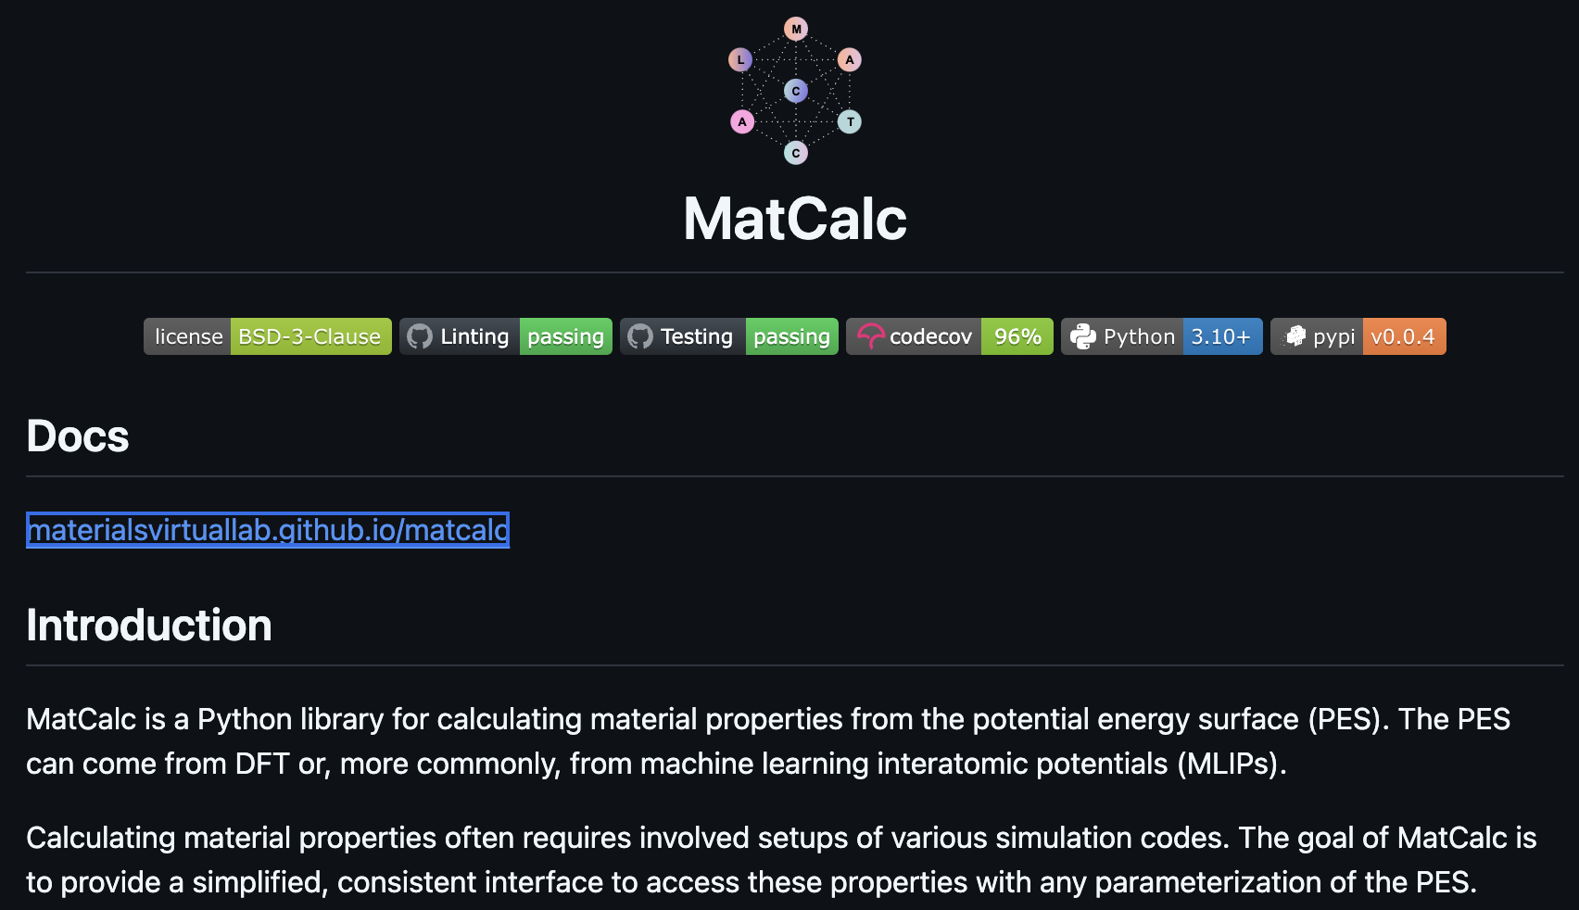
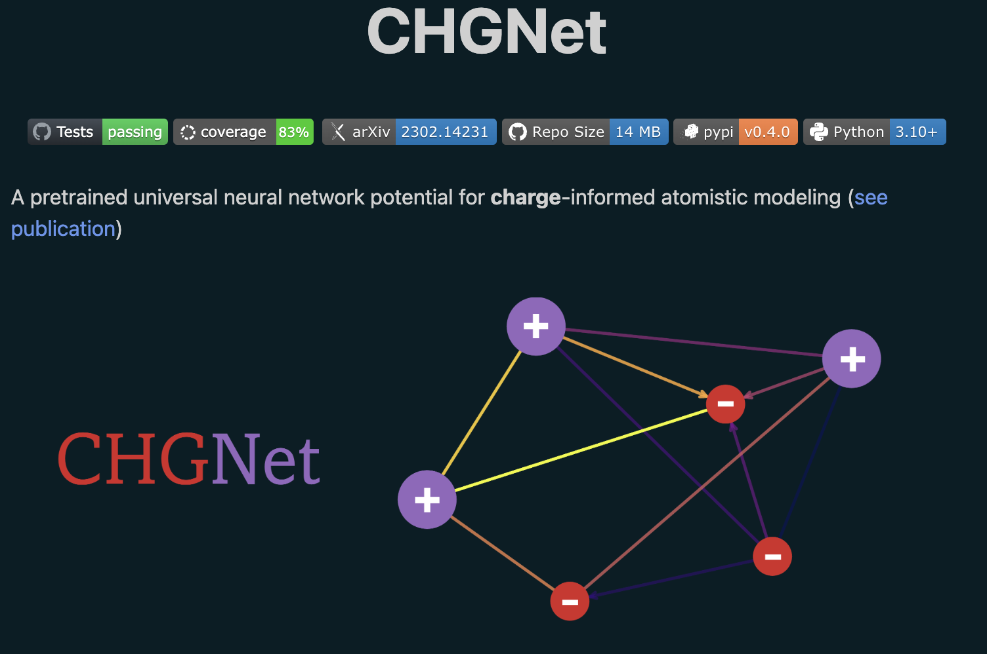
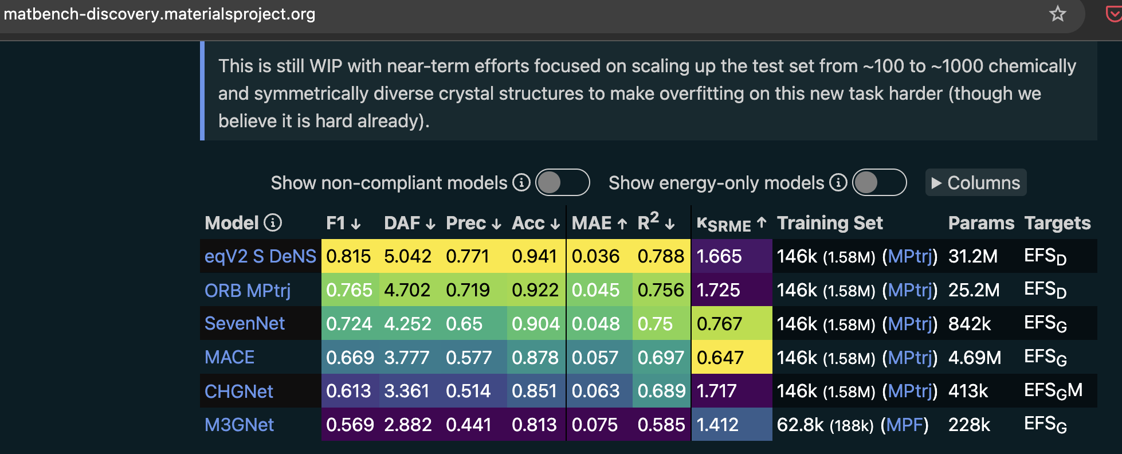
Hands-on
Know your system
Check literature for used method for similar systems
Try different tutorials first then test on your system
Keep an eye on new models through matbench website
Production runs
Tip: use matcalc if possible (simply a wrapper for different ML potentials)

Slide 7
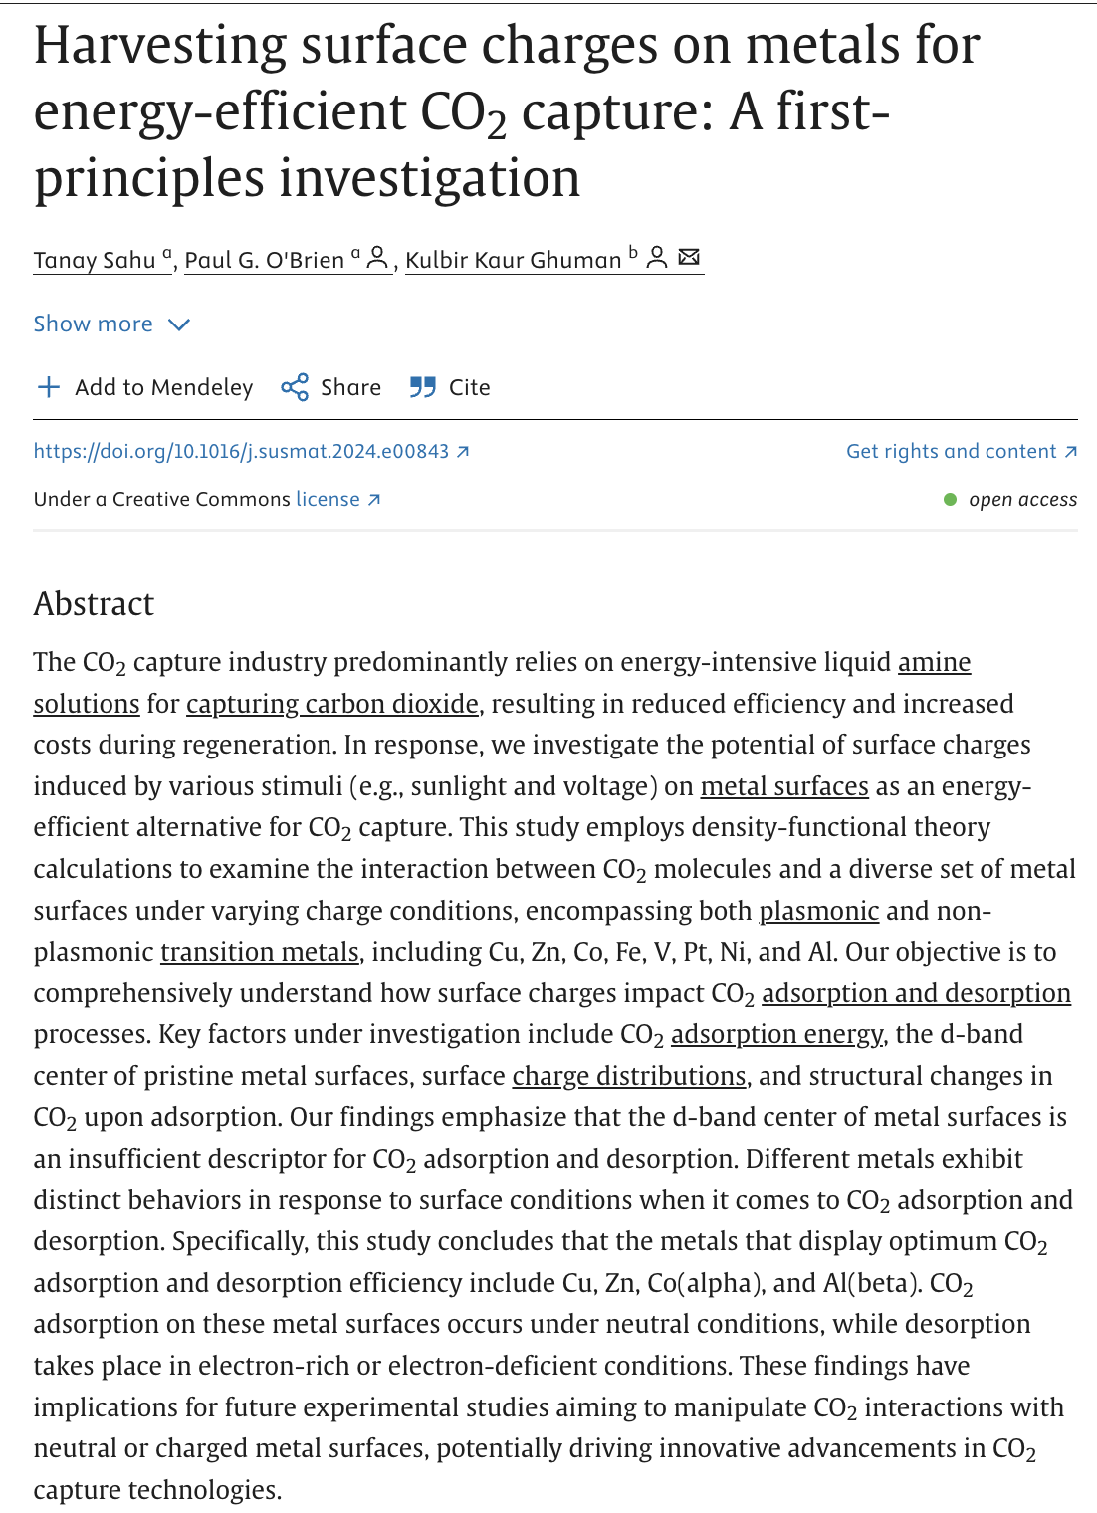
How to use ML potentials
Use toy examples
Start with replicating literature DFT results
Build your own workflow using the tools you learn
Benchmark
Use the workflows to calculate your systems

Slide 8
Computational needs and tips
Depending on the system size and ML model needs, hardware needs can differ
For most cases, probably for MSc thesis, a PC or laptop should be alright for system sizes around 100-1000 atoms
ML potentials can be a great asset when HPC clusters are hard to access
You can be good asset to augment your DFT calculations, i.e. in geometry optimisation, proof-of-concept calculations and so on
Students shouldn’t complaint anymore regarding computational resources
You should also consider semiempirical methods based on DFT data, which are close to DFT accuracy but faster (next slides)
You should equip yourself with various handy tools like ASE, RDKit, datamol..etc (next slides) and platform tools like Docker, singularity, pyenv, vs-code…etc

Slide 9
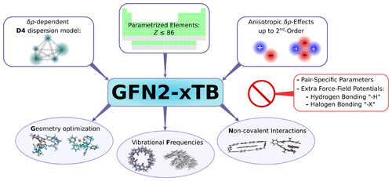
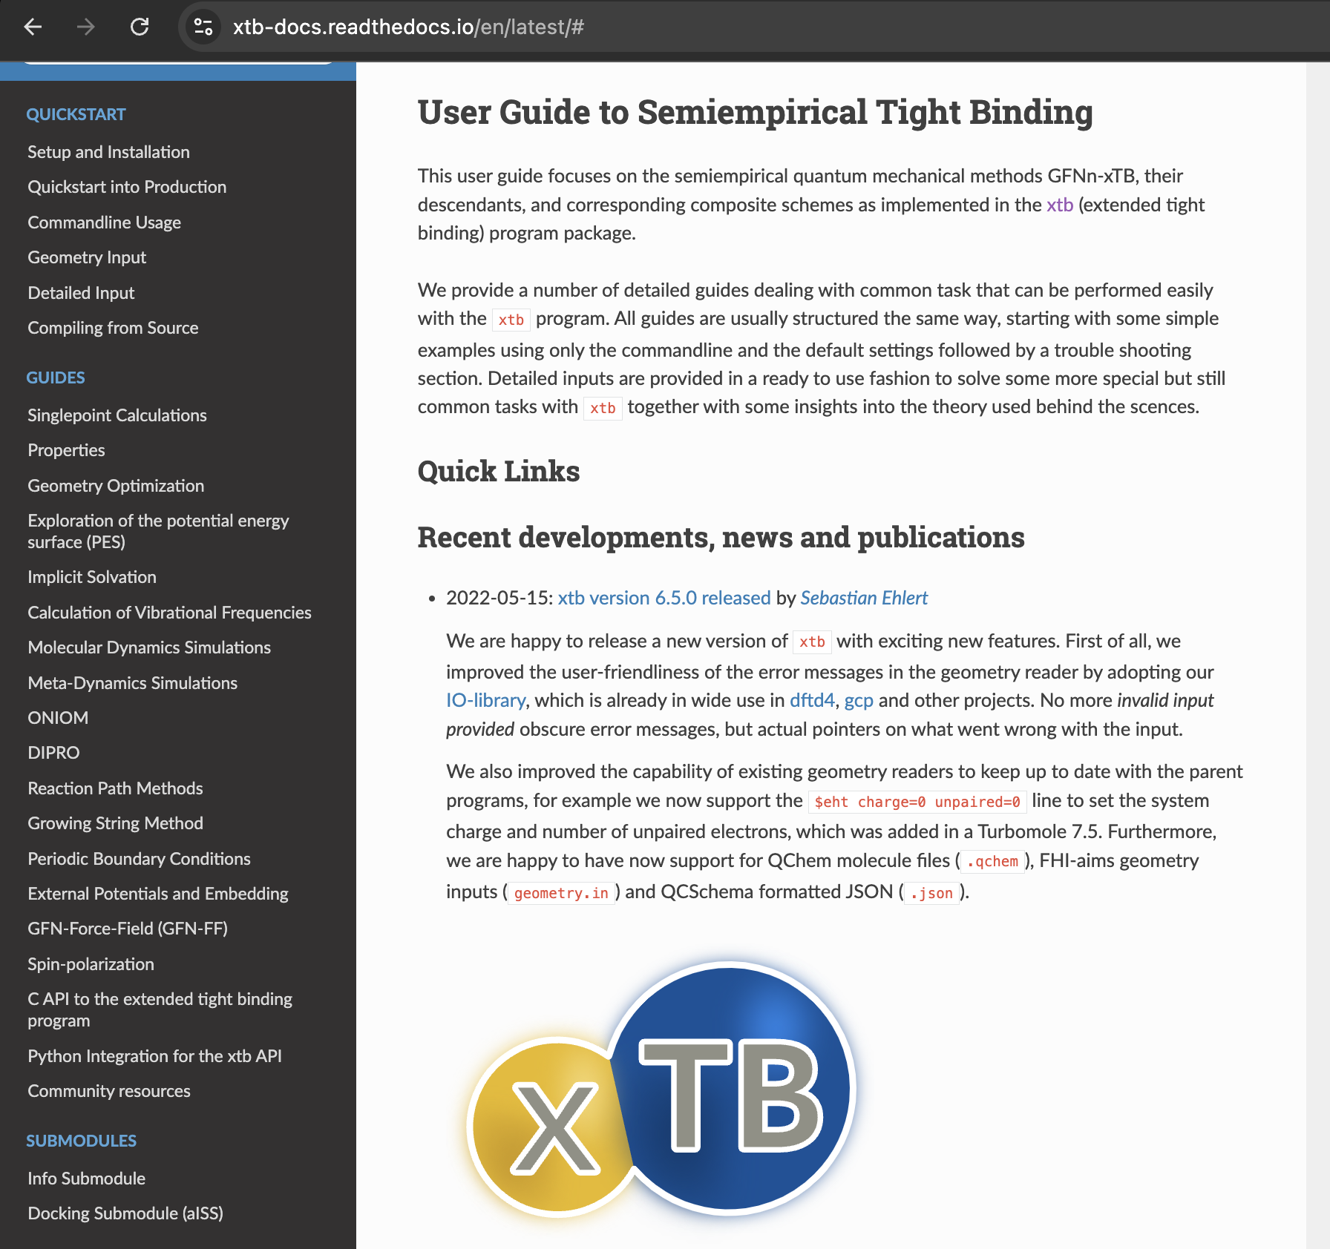
Grimme’s pool of tools
Check https://pubs.acs.org/doi/10.1021/acs.jctc.8b01176
Check https://xtb-docs.readthedocs.io/en/latest/#

Slide 10
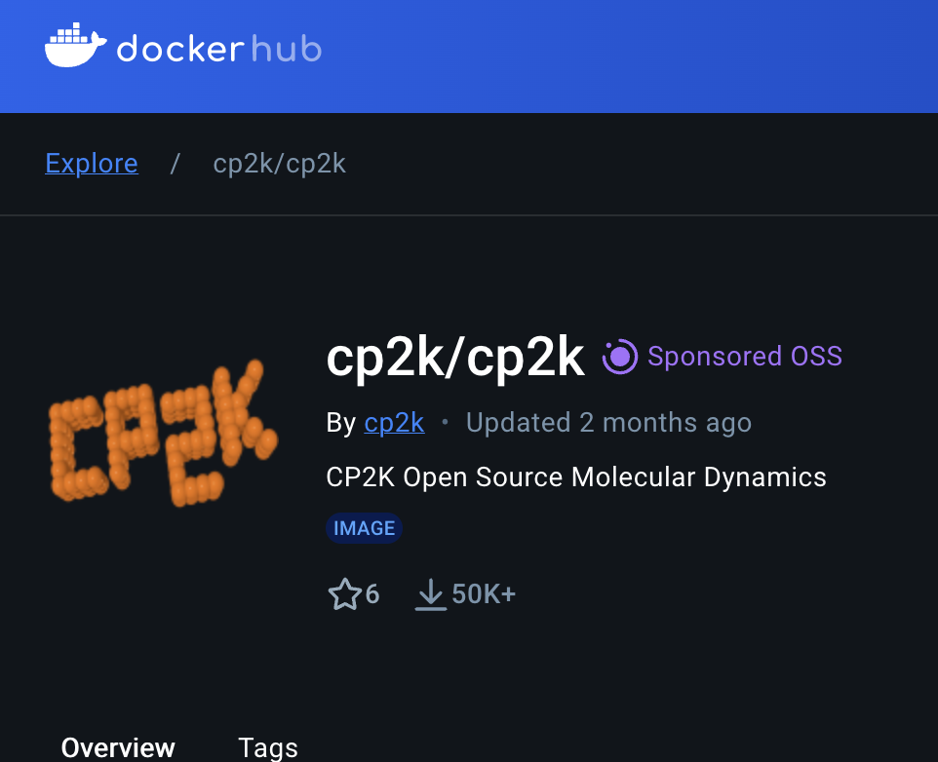
Related tools
Docker and Docker hub
VESTA for visualizations
Datamol, RDKit and related cheminformatics tools

Slide 11
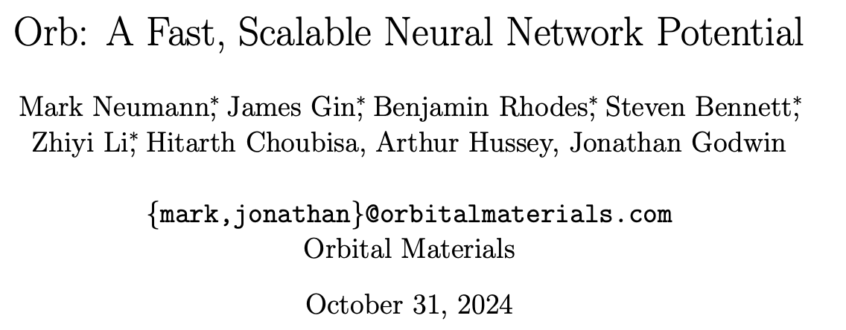
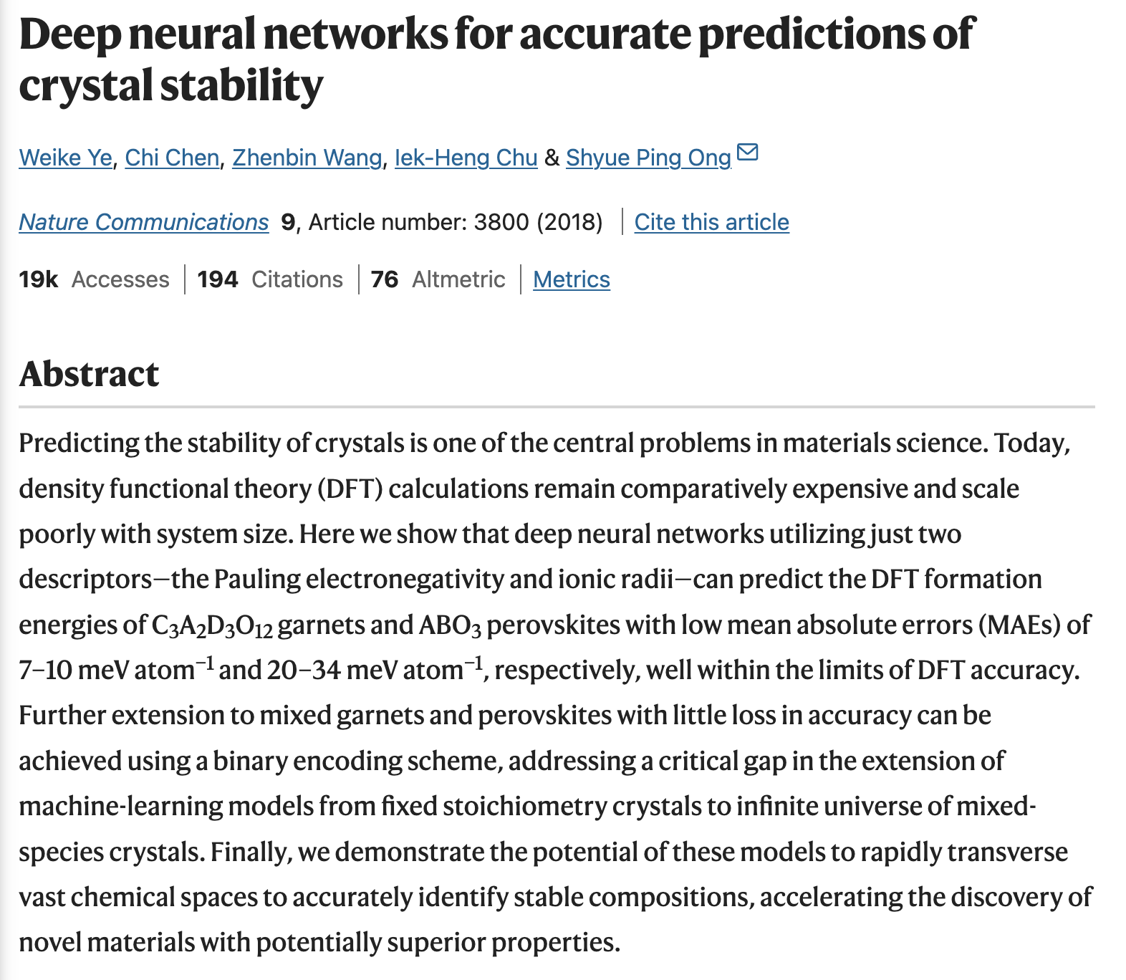
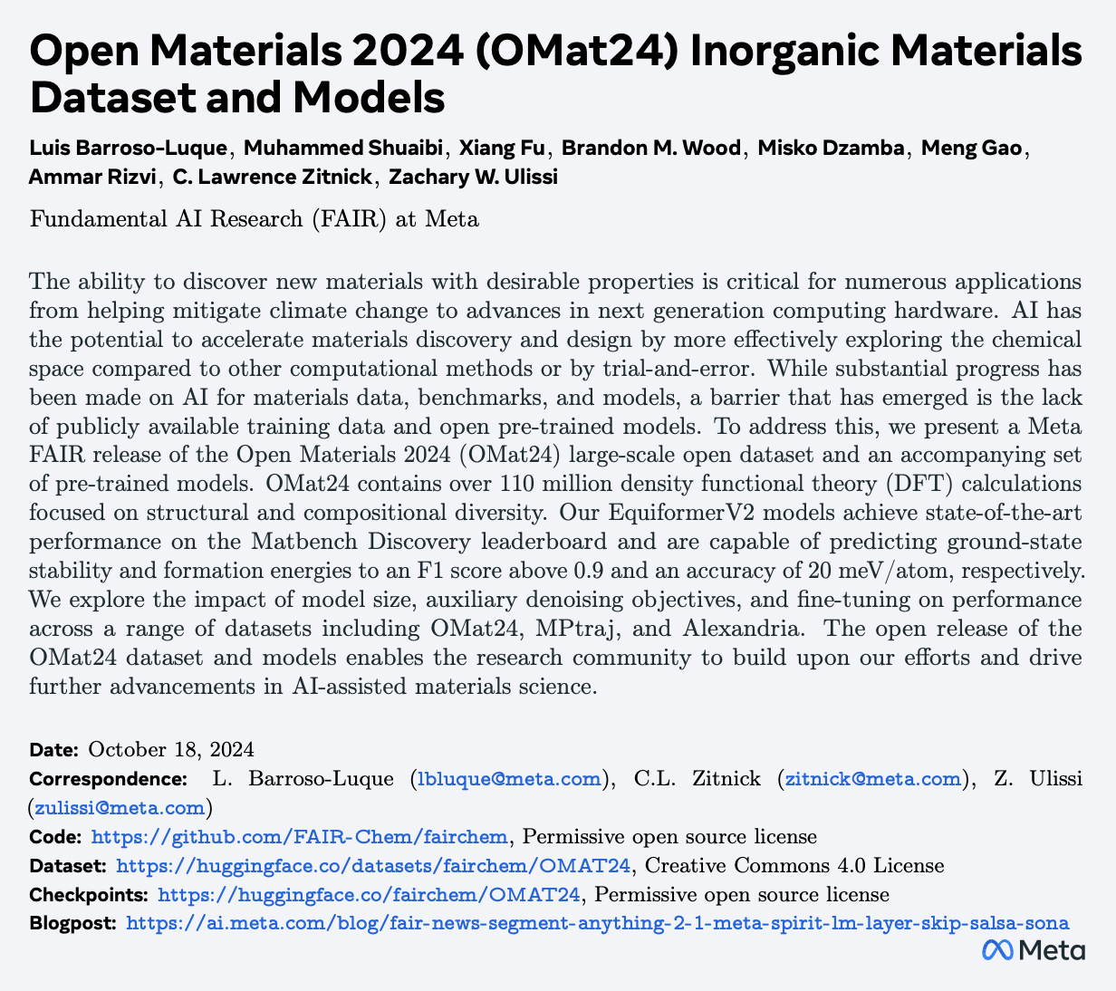
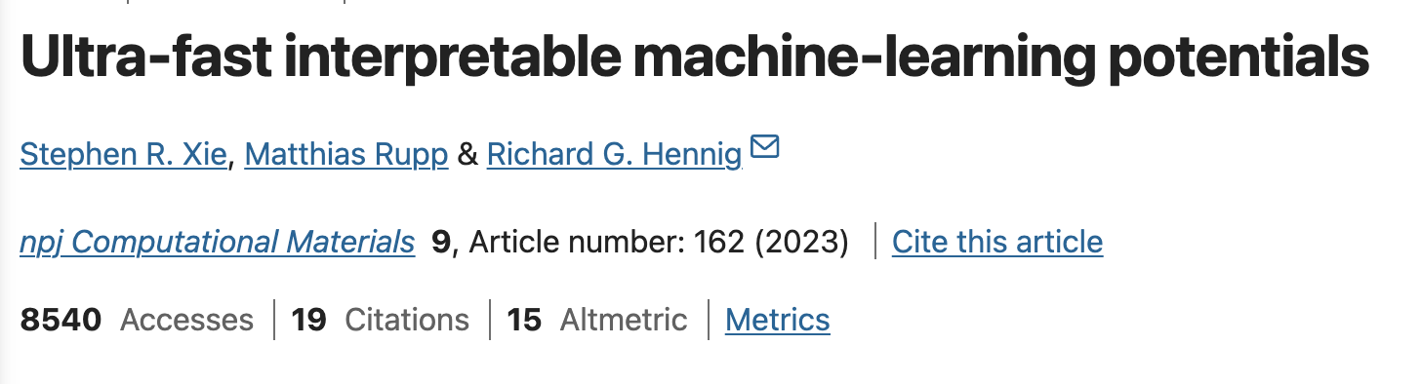
Good to read

Slide 12
Good to read
https://www.nature.com/articles/s41467-018-06322-x
https://ai.meta.com/blog/fair-news-segment-anything-2-1-meta-spirit-lm-layer-skip-salsa-sona/
https://arxiv.org/pdf/2410.12771
https://github.com/FAIR-Chem/fairchem/tree/main

